Slide 1
DATA CLEANING, DATA PREPROCESSING, and DEFINING ATTRIBUTES
In Data Mining

Slide 2
INTRODUCTION
Data mining is used to solve problems as well as decision support based on hidden information in a database.
Pattern or prediction of a parameter is delivered from data mining techniques using methods or algorithms.

Slide 3
PROBLEMS
Collected data are still dirty.
Incomplete : no attributes, no parameter
Noisy : contains of error in the data
Inconsistency : there are some differences between data
If the data are not clean, the mining result may not be better.

Slide 4
Data cleaning
Data cleaning tasks:
Data acquisition
Completing missing data
Reformatting
Data conversion (nominal to numerical, numerical to nominal)
Fixing inconsistent data

Slide 5
Data Acquisition
Data can be stored in DBMS,
Data are saved in flat file
Fixed format
Delimited format : tab, comma, “, etc.
Sequence number verification in a field

Slide 6
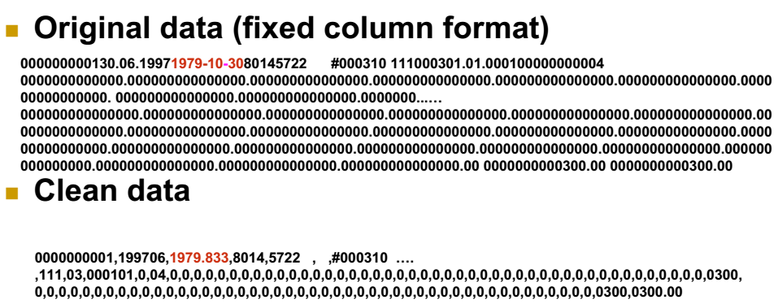
Contoh

Slide 7
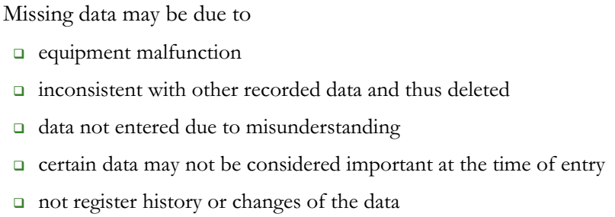
Reformatting
Data conversion into standard format, e.g csv, arff
Missing data, due to:
Broken tools
Inconsistent with other data, thus they should be removed
Data are not stored well
Particular data are not important to input
The data do not have metadata or the history of the data

Slide 8
PROBLEM SOLVING
Case study:
A graduated high school student plans to continue his study in a university. There are many universities to apply. Each university has its advantages and disadvantages. Meanwhile, the student has his own academic background.

Slide 9
PROBLEM SOLVING
Questions:
What criterions / variables influencing the student to apply in a university?
What is the most significant variable influencing the student to choose a university?
What is the prediction result for a student?

Slide 10
ATTRIBUTE / VARIABLE TYPES
2 types of variable in data mining:
Independent Variable (X) → Regular Attribute
The value of this variable is not influenced by any other variables value.
Dependent Variable (Y) → Label
The value of this variable is influenced by other value.
In a case study, the number of X or Y can be more than one.

Slide 11
DATA TYPES
CATEGORICAL (Qualitative)
Nominal (Named Categories)
Example: red, green, yellow, apple, banana
Ordinal (Categories with an implied order)
Example: high, low; big; small; fast, slow;
NUMERICAL (Quantitative)
Discrete (Only particular numbers)
Example: 0, 1; 1, 2, 3; 10, 20, 50, 100;
Continuous (Any numeric value)
Example: 0, 0.25, 1, 2.5, 5 – 10, 25%, 3⁴

Slide 12
Data Class
NUMERIC / INTEGER
If the class contains of integer (without grouped).
REAL
If the class contains of real number (without grouped), including decimals.
BINOMINAL
If the class contains only 2 classes.
POLYNOMINAL
If the class contains more than 2 classes.

Slide 13
DATA USE
Training Data
Data which are used to train a system to discover patterns or hidden information of the data.
Training data are captured from historical data happened in the past.
Testing Data
Data which are used to test the model from knowledge discovery of training data.
Usually, testing data are used to predict.

Slide 14
Data Collecting
Population
Sampling
Census
Survey

Slide 15
CASE STUDY
The following criterions are variables influencing the selection of a university for graduated students.
The University category
Tuition fee
Living cost
Decision
etc.

Slide 16
CASE STUDY
Variables:
Variable X
University category → X1
Tuition fee → X2
Living cost → X3
Variable Y
Decision → Y

Slide 17
Collecting Data (Sampling)
X1 | X2 millions/smt | X3 millions/month | Y
UGM | 5 | 1,5 | Yes
UMS | 2 | 2,5 | Yes
UMY | 6 | 2 | No
UNIBRAW | 3 | 3 | No
ITB | 5 | 3 | Yes
UII | 7 | 1,5 | No
UMJ | 5 | 4 | No
Trisakti | 7 | 4 | No
UNDIP | 6 | 1,5 | No
UNIBRAW | 3 | 2,5 | Yes

Slide 18
CASE STUDY
Data types:
University category (X1) → Nominal
Tuition fee (X2) → Ordinal
Living cost (X3) → Ordinal
Decision (Y) → Nominal

Slide 19
CASE STUDY
Data class:
University category (X1) → Binominal
Class = state ; private
Tuition fee (X2) → Polynominal
Class =
Low, if X3 ≤ 3 millions/smt;
Medium, if 3 millions/smt < X3 < 6 millions/smt
High, if X3 ≥ 6 millions/smt

Slide 20
CASE STUDY
Living cost (X3) → Polynominal
Class =
Low, if X4 < 2 millions/month;
Medium, if 2 millions/month ≤ X4 < 3 millions/month
High, if X4 ≥ 3 millions/month
Decision (Y) → Binominal
Class = Yes ; No

Slide 21
Training Data
X1 | X2 | X3 | Y
State | Medium | Low | Yes
Private | Low | Medium | Yes
Private | High | Medium | No
State | Low | High | No
State | Medium | High | Yes
Private | High | Low | No
Private | Medium | High | No
Private | High | High | No
State | High | Low | No
State | Low | Medium | Yes

Slide 22
Testing Data
X1 | X2 | X3 | Y
State | Medium | High | ?
Private | High | Low | ?
Private | Medium | High | ?

Slide 23
Data Format
Database
CSV
Excel
Access DB
ARFF
SPSS
URL
etc.

